Slide 1

An Internet of Things (IoT) Use Case Demo
Monitoring, Machine Learning, and Storage
Martin Madsen
Ph.D. in Experimental Physics
16 years’ experience working with sensors, data collection, data analysis, and predictive model building

Slide 2







Enterprise IoT Projects
Optimizing fleet and asset utilization
Reducing facility operating costs
Improving safety and security
Automating supply-chain processes
Building connected products and services
Improving cities and public spaces
Vodafone IoT Barometer 2016

Slide 3
Enterprise IoT Projects
Optimizing fleet and asset utilization
Reducing facility operating costs
Improving safety and security
Automating supply-chain processes
Building connected products and services
Improving cities and public spaces
Vodafone IoT Barometer 2016

Slide 4


Semi-structured Data

Slide 5

Machine Learning
And
Pattern Recognition
Semi-structured Data

Slide 6

Machine Learning
And
Pattern Recognition
Push
Notifications
Semi-structured Data

Slide 7
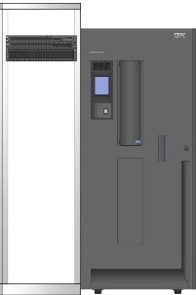
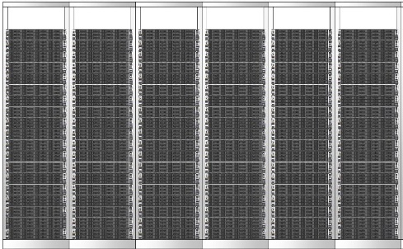

Scalable
Machine Learning
And
Pattern Recognition
Push
Notifications
Semi-structured Data
Open Source

Slide 8
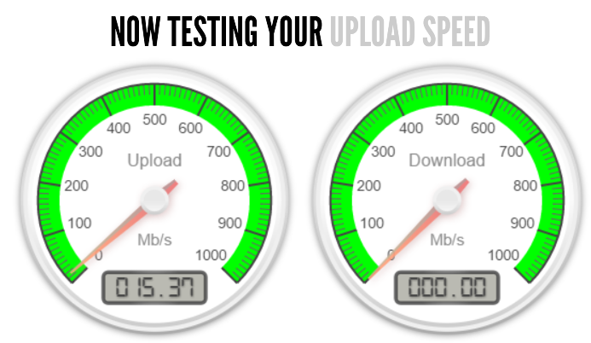

Data Source
Measurement Lab
Network Diagnostics Test
(NDT)
Key Performance Indicator Average Round-Trip Time (RTT)

Slide 9
Historical Data
Machine Learning
Real-time Monitoring
Data Exploration

Slide 10

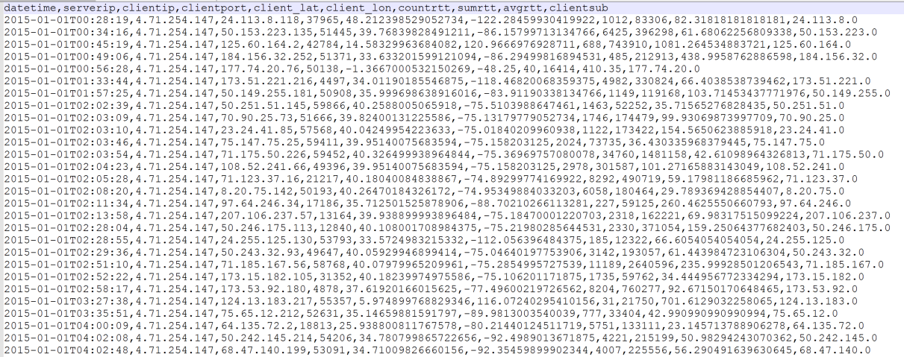
Historical NDT Data
Server: mlab1.atl01.measurement-lab.org
Client Geographical Location
Date/Time
Server/Client Network Information
Network Performance Data

Slide 11
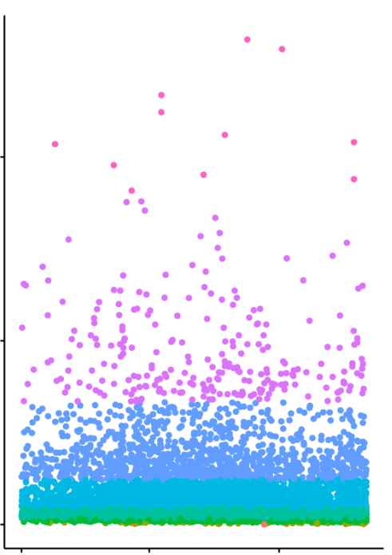
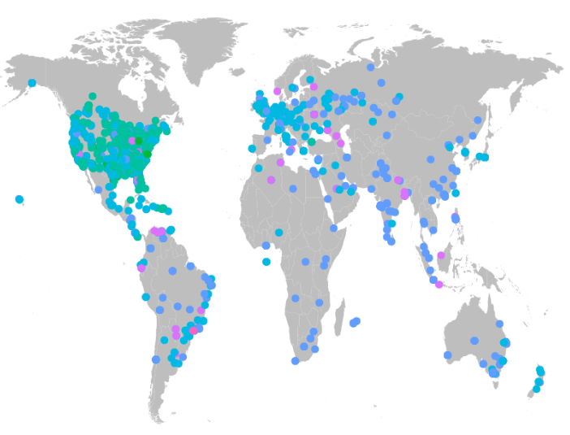

Data Exploration
Network Lag Time
Colors
RTT Log-scale Categories
Location from
Client Subnet Data
Jan 2015-May 2016

Slide 12
Data Exploration
Potential Network Problems
Network Lag Time
Colors
RTT Log-scale Categories
Location from
Client Subnet Data
Jan 2015-May 2016

Slide 13
Data Exploration
Not Isolated Geographically
Potential Network Problems
Network Lag Time
Colors
RTT Log-scale Categories
Location from
Client Subnet Data
Jan 2015-May 2016

Slide 14
Data Exploration
Not Isolated Geographically
Potential Network Problems
Network Lag Time
Colors
RTT Log-scale Categories
Location from
Client Subnet Data
Jan 2015-May 2016

Slide 15
Data Exploration
Not Isolated Geographically
Potential Network Problems
Machine Learning: Learn the typical performance for each location.
Detect outliers
Network Lag Time
Colors
RTT Log-scale Categories
Location from
Client Subnet Data
Jan 2015-May 2016

Slide 16
Outlier Detection
Is the new point an Outlier?
If the distance is larger than the group size, it may be an outlier.
Pattern Recognition: Measure the distance to the previous data.
Previous
Data
Notes:
Need previous data!!!

Slide 17
Outlier Detection
Is the new point an Outlier?
Pattern Recognition: Measure the distance to the previous data.
If the distance is larger than the group size, it may be an outlier.
Previous
Data
Example Previous Data
90 ms and 110 ms
Example New Data Point
100 ms

Slide 18
Outlier Detection
Is the new point an Outlier?
Pattern Recognition: Measure the distance to the previous data.
If the distance is larger than the group size, it may be an outlier.
Previous
Data
Example Previous Data
90 ms and 110 ms
Example New Data Point
100 ms
Notes:
Mahalanobis distance is the generalization of this

Slide 19
Outlier Detection
Is the new point an Outlier?
Pattern Recognition: Measure the distance to the previous data.
If the distance is larger than the group size, it may be an outlier.
Previous
Data
Example Previous Data
90 ms and 110 ms
Example New Data Point
100 ms
Example Average Distance
10 ms

Slide 20
Outlier Detection
Is the new point an Outlier?
Pattern Recognition: Measure the distance to the previous data.
If the distance is larger than the group size, it may be an outlier.
Previous
Data
Example Previous Data
90 ms and 110 ms
Example New Data Point
100 ms
Example Average Distance
10 ms

Slide 21
Outlier Detection
Is the new point an Outlier?
Pattern Recognition: Measure the distance to the previous data.
If the distance is larger than the group size, it may be an outlier.
Previous
Data
Example Previous Data
90 ms and 110 ms
Example New Data Point
100 ms
Example Average Distance
10 ms
Example Group Size
20 ms

Slide 22
Outlier Detection
Is the new point an Outlier?
Pattern Recognition: Measure the distance to the previous data.
If the distance is larger than the group size, it may be an outlier.
Previous
Data
Example Previous Data
90 ms and 110 ms
Example New Data Point
1000 ms
Example Average Distance
Example Group Size
20 ms

Slide 23
Outlier Detection
Is the new point an Outlier?
Pattern Recognition: Measure the distance to the previous data.
If the distance is larger than the group size, it may be an outlier.
Previous
Data
Example Previous Data
90 ms and 110 ms
Example New Data Point
1000 ms
Example Average Distance
900 ms
Example Group Size
20 ms

Slide 24
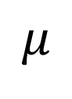
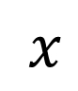
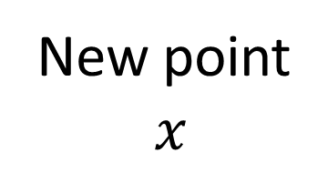
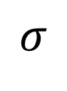
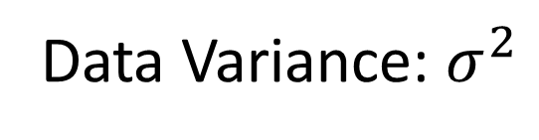
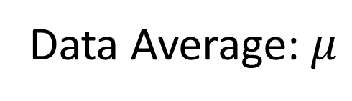
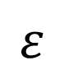
Outlier Detection
$$ε$$
Previous
Data
New point
$x$
$$σ$$
$$μ$$
$x$
Data Average: $μ$
Data Variance: $σ^{2}$

Slide 25
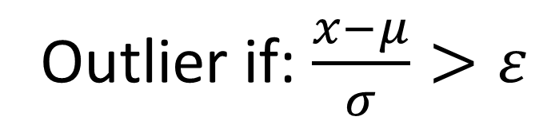
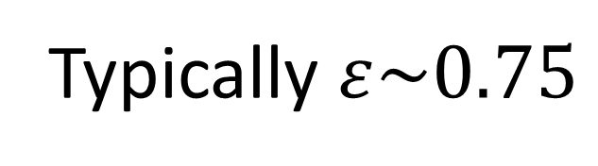
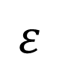
Outlier Detection
$$ε$$
Previous
Data
New point
$x$
Outlier
$$σ$$
$$μ$$
$x$
Data Average: $μ$
Outlier if: $\frac{x−μ}{σ}>ε$
Data Variance: $σ^{2}$
Typically $ε\sim 0.75$

Slide 26
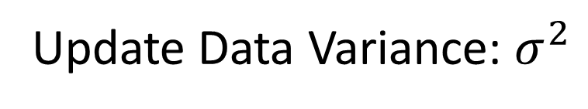
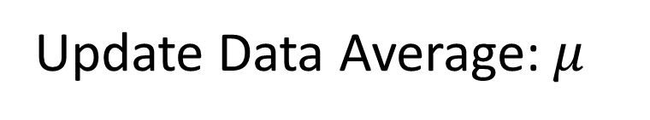
Outlier Detection
Previous
Data
Update Data Average: $μ$
Update Data Variance: $σ^{2}$

Slide 27
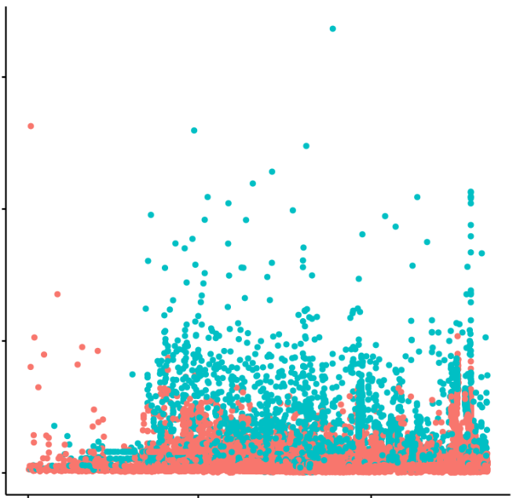
Outlier Detection
Building a pattern
Outlier
Network Lag Time
Normal
Jan 2015-May 2016

Slide 28
Outlier Detection
Building a pattern
Outlier
Normal for the client
Detected Outliers
Network Lag Time
Intelligent System –
Adjusts itself over time
based on the data pattern
Normal
Jan 2015-May 2016

Slide 29
IoT Architecture
Device/
Data Source
Data
Transport
Device and
Event Processing
Results
Presentation

Slide 30

Demo: Streaming Data Source
BigQuery
Data Storage

Slide 31
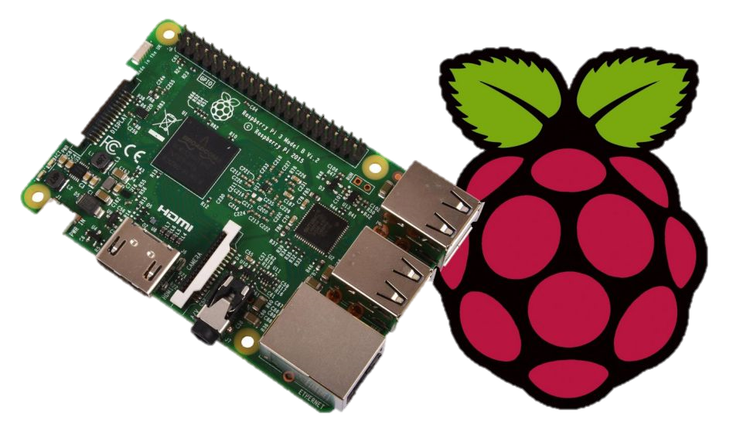
Demo: Streaming Data Source
BigQuery
Data Storage
Raspberry Pi
Gathers and Emits
Data

Slide 32


Demo: Streaming Data Source
Publish via Lightweight Machine-to-Machine
Connection
BigQuery
Data Storage
Raspberry Pi
Gathers and Emits
Data

Slide 33

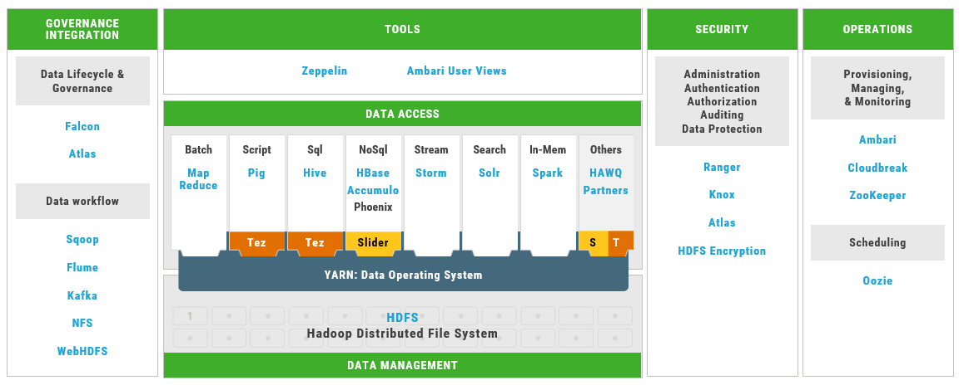
Event Processing

Slide 34
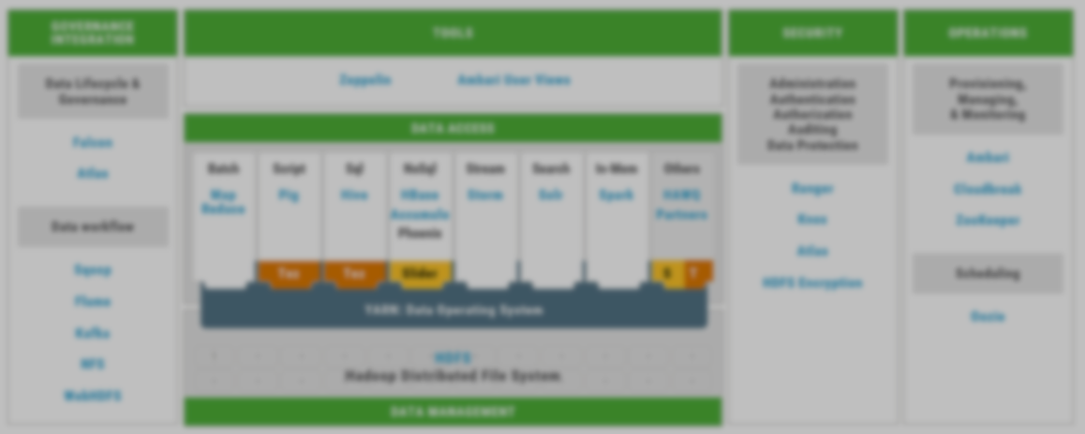
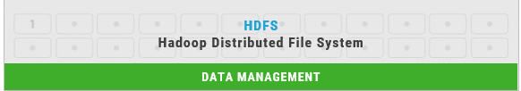
Event Processing

Slide 35
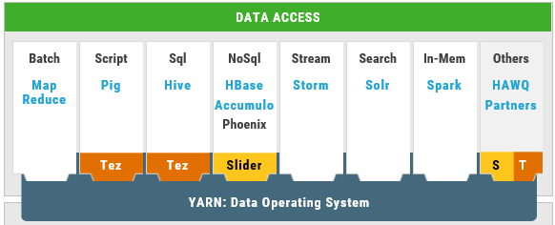

Event Processing

Slide 36
Event Processing

Slide 37
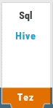
Event Processing

Slide 38





Slide 39


Outlier Prediction
Previous Data

Slide 40

Store Record
Outlier Prediction
Previous Data

Slide 41

Store Record
Outlier Prediction
Real-time Visualization
Previous Data

Slide 42
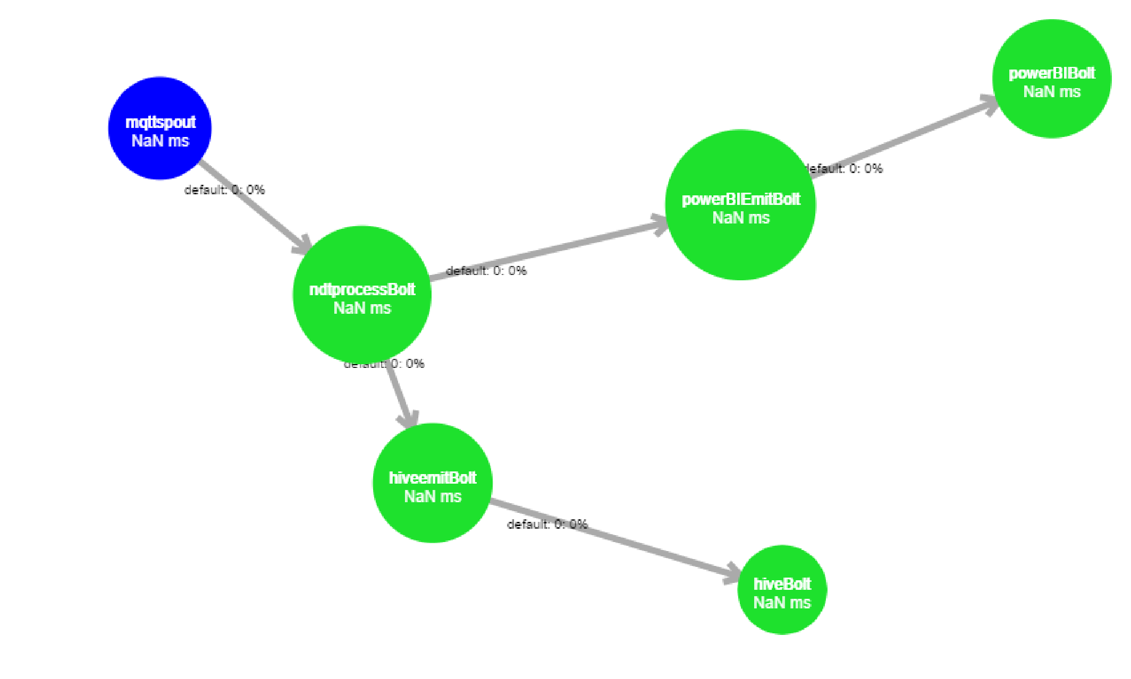


Real-time Visualization
Outlier Prediction
Grouped by
Client Subnet
Store Record

Slide 43
Actual Storm Topology
MQTT Spout:
TopologyBuilder builder = new TopologyBuilder();
builder.setSpout(MQTT_SPOUT_ID, new MQTTSpout(MQTT Broker Identification),1);
Number
of
Spouts/Bolts

Slide 44
Actual Storm Topology
MQTT Spout:
NDTProcessBolt:
TopologyBuilder builder = new TopologyBuilder();
builder.setSpout(MQTT_SPOUT_ID, new MQTTSpout(MQTT Broker Identification),1);
builder.setBolt(NDTPROCESS_BOLT_ID, new NDTProcessBolt(Prior Data), 1)
.fieldsGrouping(MQTT_SPOUT_ID, new Fields());

Slide 45
Actual Storm Topology
MQTT Spout:
NDTProcessBolt:
HiveEmitBolt:
TopologyBuilder builder = new TopologyBuilder();
builder.setSpout(MQTT_SPOUT_ID, new MQTTSpout(MQTT Broker Identification),1);
builder.setBolt(NDTPROCESS_BOLT_ID, new NDTProcessBolt(Prior Data), 1)
.fieldsGrouping(MQTT_SPOUT_ID, new Fields());
builder.setBolt(HIVEEMIT_BOLT_ID, new HiveEmitBolt(), 1)
.fieldsGrouping(NDTPROCESS_BOLT_ID, new Fields(Client Subnet));

Slide 46
Actual Storm Topology
MQTT Spout:
NDTProcessBolt:
HiveEmitBolt:
HiveBolt:
TopologyBuilder builder = new TopologyBuilder();
builder.setSpout(MQTT_SPOUT_ID, new MQTTSpout(MQTT Broker Identification),1);
builder.setBolt(NDTPROCESS_BOLT_ID, new NDTProcessBolt(Prior Data), 1)
.fieldsGrouping(MQTT_SPOUT_ID, new Fields());
builder.setBolt(HIVEEMIT_BOLT_ID, new HiveEmitBolt(), 1)
.fieldsGrouping(NDTPROCESS_BOLT_ID, new Fields(Client Subnet));
builder.setBolt(HIVE_BOLT_ID, new HiveBolt(new HiveOptions(Hive Data Store Information)), 1)
.fieldsGrouping(HIVEEMIT_BOLT_ID, new Fields(Client Subnet));

Slide 47
Actual Storm Topology
MQTT Spout:
NDTProcessBolt:
HiveEmitBolt:
HiveBolt:
PowerBIEmitBolt:
TopologyBuilder builder = new TopologyBuilder();
builder.setSpout(MQTT_SPOUT_ID, new MQTTSpout(MQTT Broker Identification),1);
builder.setBolt(NDTPROCESS_BOLT_ID, new NDTProcessBolt(Prior Data), 1)
.fieldsGrouping(MQTT_SPOUT_ID, new Fields());
builder.setBolt(HIVEEMIT_BOLT_ID, new HiveEmitBolt(), 1)
.fieldsGrouping(NDTPROCESS_BOLT_ID, new Fields(Client Subnet));
builder.setBolt(HIVE_BOLT_ID, new HiveBolt(new HiveOptions(Hive Data Store Information)), 1)
.fieldsGrouping(HIVEEMIT_BOLT_ID, new Fields(Client Subnet));
builder.setBolt(POWERBIEMIT_BOLT_ID, new PowerBIEmitBolt(), 1)
.fieldsGrouping(NDTPROCESS_BOLT_ID, new Fields(Client Subnet));

Slide 48
Actual Storm Topology
MQTT Spout:
NDTProcessBolt:
HiveEmitBolt:
HiveBolt:
PowerBIEmitBolt:
PowerBIBolt:
TopologyBuilder builder = new TopologyBuilder();
builder.setSpout(MQTT_SPOUT_ID, new MQTTSpout(MQTT Broker Identification),1);
builder.setBolt(NDTPROCESS_BOLT_ID, new NDTProcessBolt(Prior Data), 1)
.fieldsGrouping(MQTT_SPOUT_ID, new Fields());
builder.setBolt(HIVEEMIT_BOLT_ID, new HiveEmitBolt(), 1)
.fieldsGrouping(NDTPROCESS_BOLT_ID, new Fields(Client Subnet));
builder.setBolt(HIVE_BOLT_ID, new HiveBolt(new HiveOptions(Hive Data Store Information)), 1)
.fieldsGrouping(HIVEEMIT_BOLT_ID, new Fields(Client Subnet));
builder.setBolt(POWERBIEMIT_BOLT_ID, new PowerBIEmitBolt(), 1)
.fieldsGrouping(NDTPROCESS_BOLT_ID, new Fields(Client Subnet));
builder.setBolt(POWERBI_BOLT_ID, new PowerBIBolt(PowerBI Access Information), 1)
.shuffleGrouping(POWERBIEMIT_BOLT_ID);
StormSubmitter.submitTopology(topology name, configuration, builder.createTopology());

Slide 49
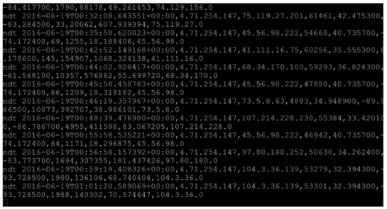
Recording of streaming data from IoT device
Data from
2016-05-04

Slide 50
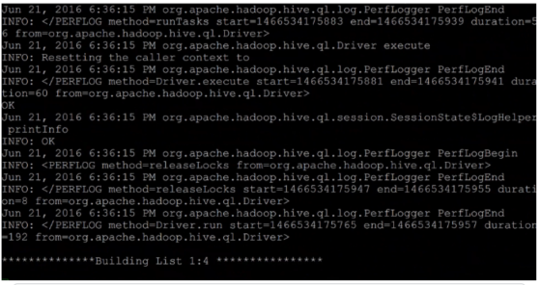
Recording of data from Storm Debug Monitor
Data from
2016-05-04

Slide 51

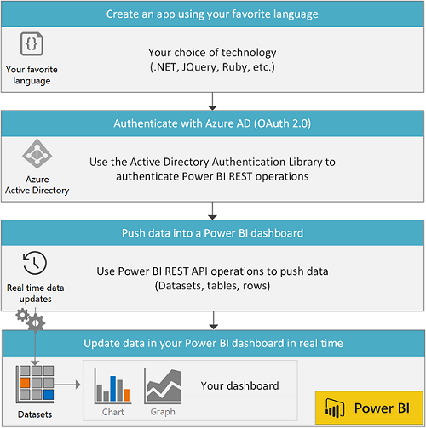

Slide 52
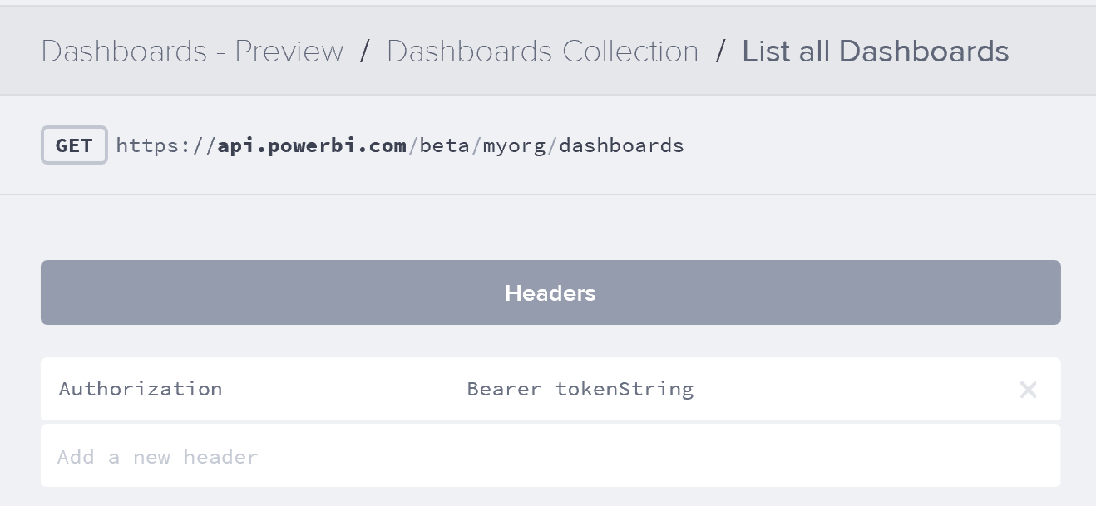
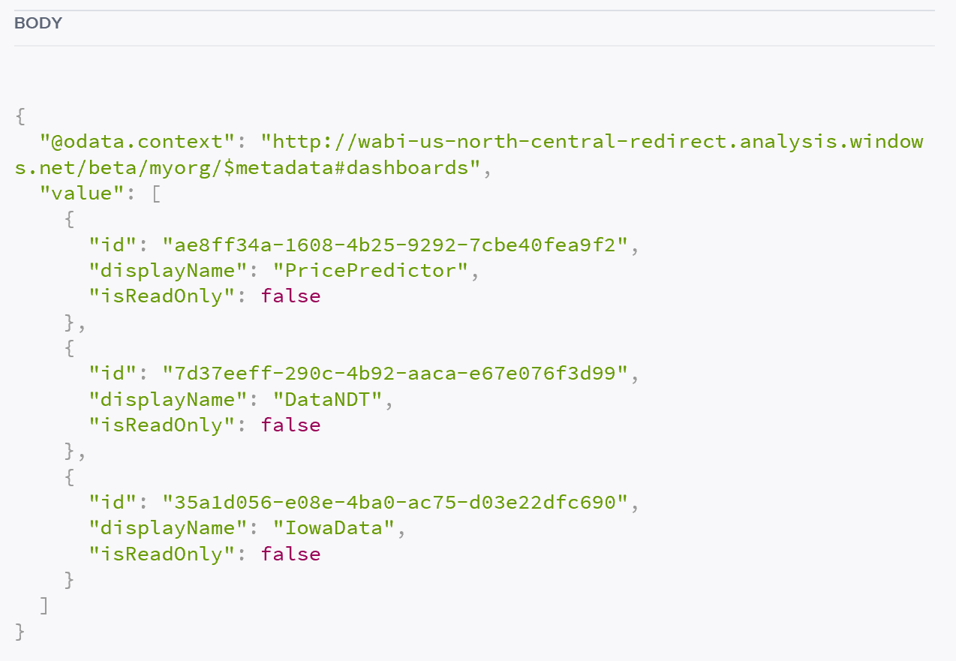

Slide 53
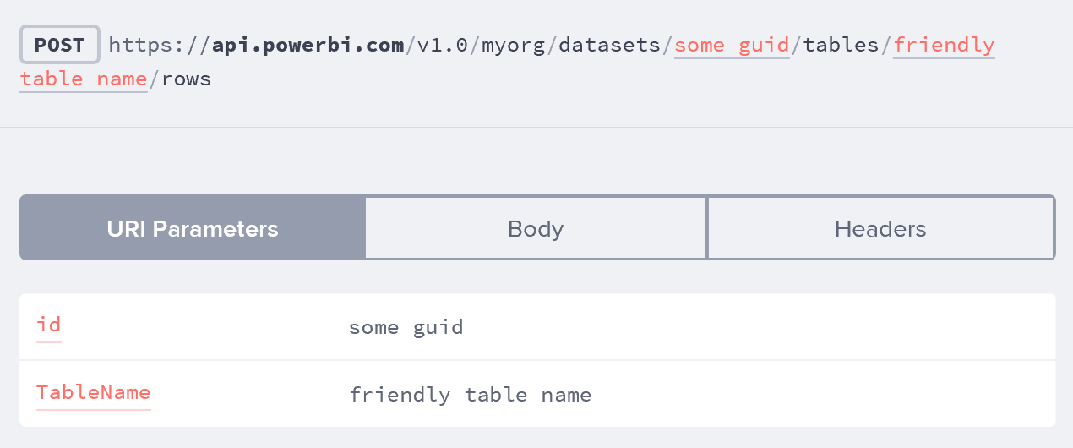
Posting Rows to a Dataset:

Slide 54
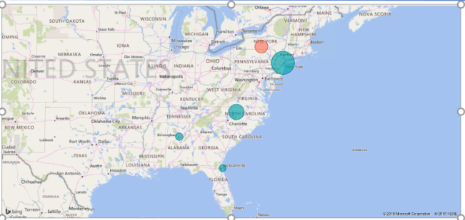
Recording of Event Stream in Power BI
Data from 2016-05-04

Slide 55

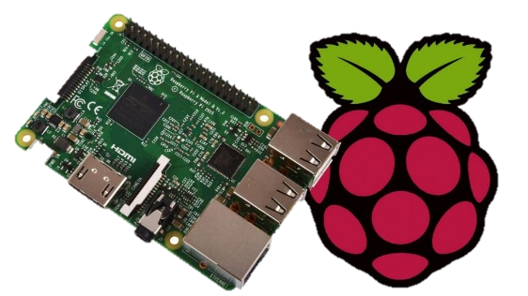
Summary
IoT Data Source
Notes:
IoT – semistructured data coming in from devices
Machine Learning- learn patterns from each device
Outlier Identification – flag and broadcast when something doesn’t look right
Open Source and Scalable – Hadoop architecture
Easy-to-read dashboards – Power BI output – integrate with existing enterprise systems
??Delivery of notifications via twitter?

Slide 56



Summary
Storm
Streaming Analytics
IoT Data Source
Open Source
Notes:
IoT – semistructured data coming in from devices
Machine Learning- learn patterns from each device
Outlier Identification – flag and broadcast when something doesn’t look right
Open Source and Scalable – Hadoop architecture
Easy-to-read dashboards – Power BI output – integrate with existing enterprise systems
??Delivery of notifications via twitter?

Slide 57

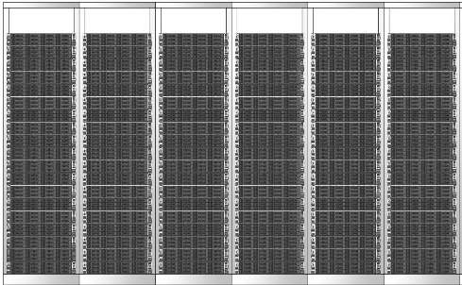
Summary
Scalable
Storm
Streaming Analytics
IoT Data Source
Expandable and Scalable
Open Source
Notes:
IoT – semistructured data coming in from devices
Machine Learning- learn patterns from each device
Outlier Identification – flag and broadcast when something doesn’t look right
Open Source and Scalable – Hadoop architecture
Easy-to-read dashboards – Power BI output – integrate with existing enterprise systems
??Delivery of notifications via twitter?

Slide 58
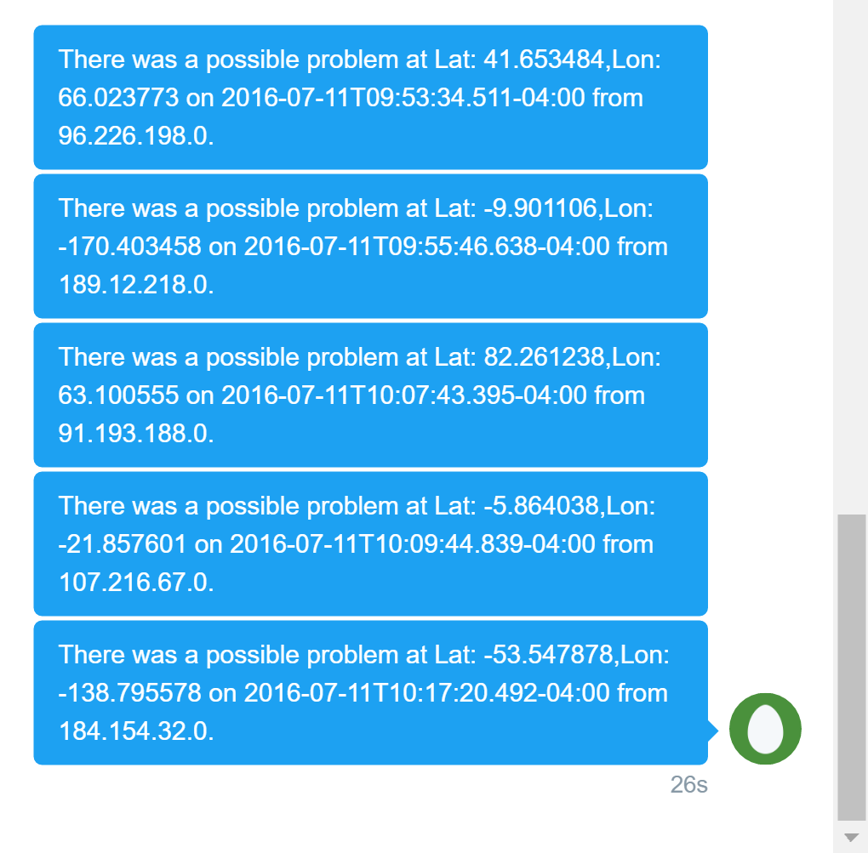


Twitter Message Notification

Slide 59
Developer Resources
PROCESSING STREAMING DATA IN HADOOP WITH APACHE STORM
http://hortonworks.com/hadoop-tutorial/processing-streaming-data-near-real-time-apache-storm/
REALTIME EVENT PROCESSING IN HADOOP WITH NIFI, KAFKA AND STORM
https://hortonworks.com/hadoop-tutorial/realtime-event-processing-nifi-kafka-storm/
https://github.com/pmhargisNG10/TruckEventsTutorial
Storm Hive Bolt
https://github.com/apache/storm/tree/master/external/storm-hive
Storm MQTT Integration
http://storm.apache.org/releases/2.0.0-SNAPSHOT/storm-mqtt.html
https://github.com/shirou/storm-mqtt
Power BI REST API
https://powerbi.microsoft.com/en-us/developers/
https://moraschi.com/2015/07/16/there-oauth-to-be-a-better-way-power-bi/
Notes:
Last Slide wrap up – resources for developers

Slide 60
Thank You!
Questions, comments, or further conversation:
Martin John Madsen
https://www.linkedin.com/in/martinjohnmadsen

